Slide 1
Chapter 1
Introduction

Slide 2
Overview
1.1 Definition, Foundation, History of Artificial Intelligence
1.2 Definition and Importance of Knowledge
1.3 Cognition and Learning
1.4 Human Intelligence and Machine Intelligence
1.5 AI Tree: Branches and Interdisciplinary Nature
1.6 Intelligent Agents and Types
1.7 Agentic AI

Slide 3
1.1 Definition, Foundation, History of Artificial Intelligence
Definition of Artificial Intelligence:
Meaning of the word: ``Intelligence'‘
The ability to reason
The ability to understand
The ability to create
The ability to learn from past experience
The ability to plan and execute complex task

Slide 4
What Behaviors are Intelligent?
Everyday tasks:
recognize a friend, recognize who is calling, translate from one language to another, interpret a photograph, talk, cook a dinner
Formal tasks:
prove a logic theorem, geometry, calculus, play chess, checkers, or Go
Expert tasks:
engineering design, medical design, financial analysis

Slide 5
Artificial Intelligence
Based on the above definition of intelligence, `artificial intelligence' is the branch of the science and engineering necessary to create artifacts that can
acquire knowledge, i.e., can learn and extract knowledge; and
reason with knowledge (leading to doing tasks such as planning, explaining, diagnosing, acting rationally, etc.),
it is the branch of science concerned with making computers behave like humans
AI is the science of making intelligent machines, especially intelligent computer programs

Slide 6
Artificial Intelligence
According to Barr and Feigenbaum, “Artificial Intelligence is the part of computer science concerned with designing intelligent computer systems, that is, systems that exhibit the characteristics we associate with intelligence in human behavior.”
According to Elaine Rich, “AI is the study of how to make computers do things at which, at the moment, people are better”.
An AI System should have:
Capability to provide reason about something
Capability of Natural Language Processing
Capability of learning from past experience
Capability of self correction

Slide 7
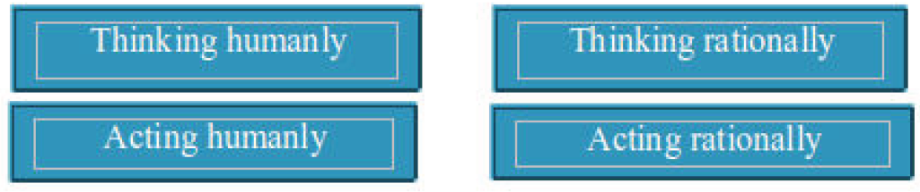
View of AI falls under four categories

Slide 8
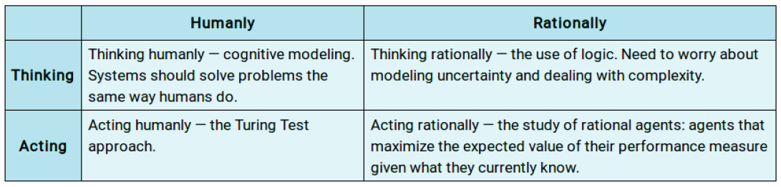

Slide 9
Thinking Humanly: The Cognitive Modelling Approach
If we are going to say that a given program thinks like a human, we must have some way of determining how human thinks.
We need to get inside the actual working of human minds.
Three ways of doing this is:
Introspection=trying to catch our own thoughts as they go by;
psychological experiments=observing a person in action;
brain imaging=observing the brain in action
Once we have a sufficiently precise theory of the mind, it becomes possible to express the theory as a computer program.
If the program’s input/output and timing behavior matches human behavior, that is evidence that some of the program’s mechanisms may also be operating in humans.
Activities that we associate with human thinking are decision-making, problem solving, learning, etc.

Slide 10
Acting Humanly: The Turing Test Approach
The Turing test originally called the Imitation Game is a method for determining whether or not a computer is capable of thinking like a human.
The test is named after Alan Turing, an English mathematician who pioneered artificial intelligence during the 1940s and 1950s, and who is credited with devising the original version of test.
According to this kind of test, a computer is deemed to have artificial intelligence if it can mimic human responses under specific conditions.

Slide 11
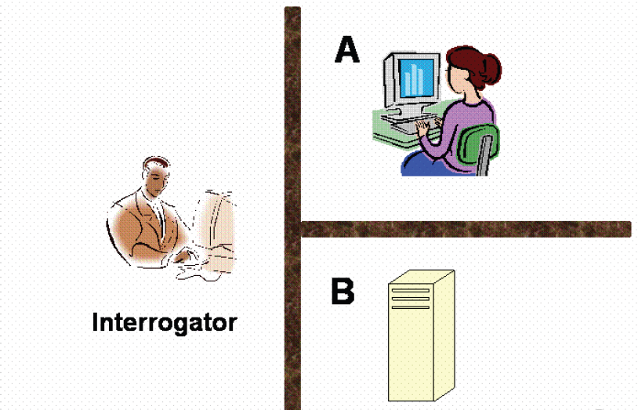
The Turing Test Approach

Slide 12
The Turing Test Approach
Consider the following scenario:
There are two rooms, A and B.
One of the rooms contain a computer. The other contains a human.
The interrogator is outside and does not know which one is a computer.
He can ask questions through a teletype and receives answers from both A and B.
The interrogator needs to identify whether A or B are humans.
To pass the Turing test, the machine has to fool the interrogator into believing that it is human.
The unofficial “Total Turing Test” adds that the interrogation should also involve visual activity and physical interaction.

Slide 13
The Turing Test Approach
Few examples are:
1. ELIZA (1966)
computer programs that could have a conversation with people made by Joseph Weizenbaum.
worked by finding patterns in what you said and giving a response that sounded like it understood you.
really good at making people think it knew what they were talking about especially when it was pretending to be a therapist.
did not really understand what people were saying & could only have conversations and did not know what the conversations were actually, about.
2. Mitsuku (Kuki) (2005 - Present)
Mitsuku, also known as Kuki, is a chatbot developed by Steve Worswick.
known for its vast database of conversational knowledge and its ability to engage in lengthy, coherent dialogues.

Slide 14
The Turing Test Approach
Turing test are continually evolving to maintain relevance during technological advancements.
1. The Reverse Turing Test aims to have a human trick a computer into having the computer believe it is not interrogating a human.
In a Reverse Turing Test, a human must prove they are not a machine.
Examples:
1. CAPTCHAs: The little puzzles like: “Select all crosswalks”, “Type the distorted letters”, “Solve this simple math puzzle”
2. Behavior-based Detection: Some systems analyze mouse movement, typing cadence and reaction time, to determine whether a real human is interacting.
3. Human Verification Prompts: When websites ask “Are you a robot?” and require a checkbox or puzzle, that’s a reverse Turing test.

Slide 15
Turing Test vs Reverse Turing Test
Turing Test | Reverse Turing Test
Machine is tested. | Human is tested.
Human is the interrogator or evaluator. | Machine is the interrogator or evaluator.
Evaluate if a machine can act like a human. | Verify if the user is human.
AI passes if it fools the human. | Human passes if they prove they’re not a bot.
Extensively used in the field of AI research, cognitive science. | Used in Cybersecurity, anti-spam, fraud prevention.
Examples: Chatbots, AI conversation tests | CAPTCHAs, “I’m not a robot” checks.

Slide 16
The Turing Test Approach
2. The Total Turing Test
incorporates perceptual abilities and the person being question's ability to manipulate objects.
It extends the classic Turing Test by requiring a machine to imitate not only human conversation, but also human perception and physical interaction.
The Total Turing Test evaluates whether a machine can:
1. Perceive the world i.e. Identify visual objects, Recognize faces, Understand spoken language, Interpret sounds
2. Interact physically i.e. Manipulate objects, Perform motor tasks, Show human-like actions
3. Use knowledge & reasoning i.e. Combine sensory input with cognition, Respond naturally like a human.
To pass the total Turing Test, the computer will need
computer vision to perceive objects, and
robotics to move them about
The Total Turing Test pushes AI toward: Robotics, Autonomous agents, Human-like perception, Cognitive reasoning

Slide 17
Turing Test Vs Total Turing Test
Turing Test | Total Turing Test
Test is text-based only. | Test is multimodal that includes speech, vision and touch.
It tests linguistic intelligence of a machine. | It tests linguistic, sensory & physical intelligence of a machine.
Doesn’t require any physical embodiment. | Requires robotics or sensors embodiment.
Test has lower complexity. | Complexity is much higher.

Slide 18
The Turing Test Approach
3. The Marcus Test has test subjects view media and respond to questions about the content consumed.
4. The Minimum Intelligent Signal test asks test subjects only binary questions (i.e. only true/false or yes/no answers are allowed).

Slide 19
The Turing Test Approach
To pass a Turing test, a computer must have following capabilities:
Natural Language Processing:
Must be able to communicate in English successfully
Knowledge representation:
To store what it knows and hears.
Automated reasoning:
Answer the Questions based on the stored information.
Machine learning:
Must be able to adapt in new circumstances

Slide 20
Thinking Rationally: The “Laws of Thought Approach”
The study of mental faculties through the use of computational models.
The study of computations that make it possible to perceive, reason and act.
The Greek philosopher Aristotle was one of the first to attempt to codify “right thinking”
His famous syllogisms provided patterns for argument structures that always gave correct conclusions given correct premises.
For example, “Socrates is a man; all men are mortal; therefore, Socrates is mortal.” These laws of thought were supposed to govern the operation of the mind, and initiated the field of logic.
Logic requires knowledge of the world that is certain— a condition that, in reality, is seldom achieved. We simply don’t know the rules of, say, politics or warfare in the same way that we know the rules of chess or arithmetic.
The theory of probability fills this gap, allowing rigorous reasoning with uncertain information.
In Probability principle, it allows the construction of a comprehensive model of rational thought, leading from raw perceptual information to an understanding of how the world works to predictions about the future. What it does not do, is generate intelligent behavior. For that, we need a theory of rational action.

Slide 21
Acting Rationally: “The Rational Agent Approach”
An agent is just something that acts.
Of course, all computer programs do something, but computer agents are expected to do more: operate autonomously, perceive their environment, persist over a prolonged time period, adapt to change, and create and pursue goals.
A rational agent is one that acts so as to achieve the best outcome or, when there is uncertainty, the best expected outcome.
The rational agent approach to AI has prevailed throughout most of the field’s history.
In the early decades, rational agents were built on logical foundations and formed definite plans to achieve specific goals also known as Symbolic AI.
Later, methods based on probability theory and machine learning allowed the creation of agents that could make decisions under uncertainty to attain the best expected outcome also known as Statistical AI.
Hence, in this approach, AI is viewed as the study and construction of rational agents i.e. agents that do the right thing where “the right thing” is defined by the objective that we provide to the agent.

Slide 22
Can Machine Really Think?
1. What Does It Mean to "Think"?
Thinking can involve various processes, such as:
Logical reasoning.
Problem-solving.
Decision-making.
Creativity.
Awareness and understanding.
AI systems excel at some of these tasks but struggle with others. The distinction between human thinking and what machines do lies in consciousness, intention, and understanding.

Slide 23
Can Machine Really Think?
2. How Do Machines "Think"?
Machines don't think in the way humans do. Instead, they process information using algorithms and data:
Pattern Recognition: AI systems analyze patterns in data to make predictions or decisions.
Rules-Based Processing: Machines follow predefined rules to solve problems (e.g., chess algorithms).
Learning from Data: Through machine learning, AI systems improve their performance over time, appearing to "learn."
For example: A machine learning model like ChatGPT generates responses based on patterns in text data it has been trained on. It doesn’t "understand" the text or have an internal thought process. It simply calculates probabilities of word sequences.

Slide 24
Can Machine Really Think?
3. Differences Between Machine and Human Thinking
a. Absence of Consciousness
Machines lack self-awareness or subjective experiences.
Humans think with emotions, creativity, and intuition, which are deeply tied to consciousness.
b. Lack of Intentionality
Human thinking is often goal-driven and intentional.
Machines only perform tasks they are programmed or trained for.
c. Understanding vs. Simulation
Humans understand concepts and can generalize knowledge.
Machines simulate understanding by correlating data but don't grasp meaning.

Slide 25
Can Machine Really Think?
Strong AI vs. Weak AI
Weak AI (Narrow AI)
Machines perform specific tasks (e.g., voice recognition, medical diagnosis).
They simulate thinking but don't possess awareness or consciousness.
Example: Siri, Google Translate.
Strong AI (General AI)
Hypothetical systems with human-like general intelligence.
Can understand, reason, and apply knowledge across a broad range of tasks.
As of now, strong AI does not exist, and machines cannot "truly think."

Slide 26
Can Machine Really Think?
4. Can Machines Ever Truly Think?
While current AI does not "think" in a human sense, there are debates about the future:
Yes, Machines Might Think
  If consciousness can emerge from complex computations, machines may someday think.
  Advances in neuromorphic computing (mimicking the human brain) could lead to more human-like AI.
No, Machines Will Never Think
  Critics argue that thinking requires consciousness, emotion, and understanding, which may not be programmable.

Slide 27
Brief History of AI
The term “Artificial Intelligence” was used for the first time in 1956 by an American scientist John McCarthy who is referred to as the Father of AI.
McCarthy also come up with a programming language called LISP (i.e. List-Processing), which is still used to program computer in AI that allow the computer to learn.
Further, the major achievements can be listed as below:

Slide 28
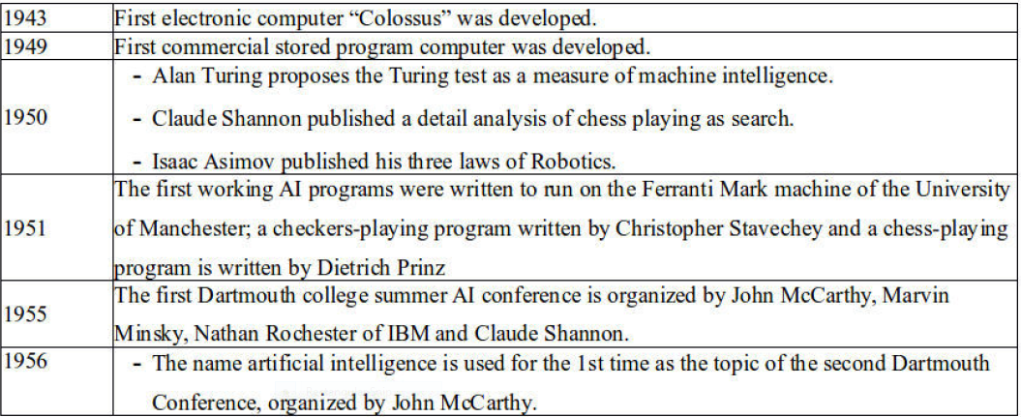
Brief History of AI

Slide 29
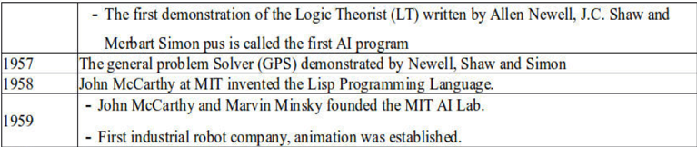
Brief History of AI

Slide 30
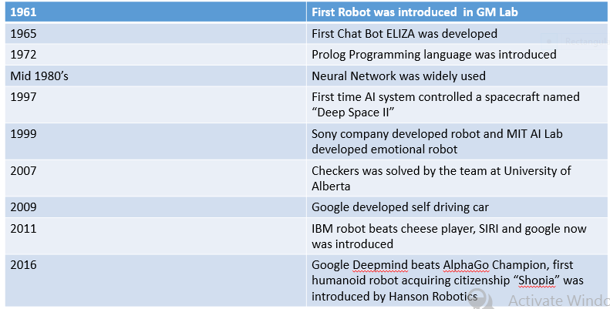
Brief History of AI

Slide 31
Brief History of AI
2016 | The AI audio generator WaveNet is launched
2017 | The birth of deepfakes
2017 | The first ‘Transformer’ lays the technological foundation for large language models (LLMs)
2018 | OpenAI releases GPT-1
2020 | Generative AI goes mainstream (GPT-3.5)
2023 | The release of Chat GPT-4

Slide 32
Brief History of AI
Key Recent Developments in AI (2024–2025):
Rise of “Agentic AI” and Autonomous AI Agents:
Example: Manus AI, described as capable of reasoning, planning, performing end-to-end tasks across domains like healthcare, manufacturing, robotics.
AI + Biotechnology and Science Integration
Example: After Fourth Industrial Revolution (4IR) and 5th Biotech Revolution (Biotech 5.0), AI is now actively being used to accelerate breakthroughs in biotechnology and medicine speeding up drug design, genomics (gene editing), diagnostics, and other biotech areas.

Slide 33
1.2 Definition and Importance of Knowledge
Knowledge Definition
“The fact or condition of knowing something with familiarity gained through experience or association.” (Webster’s Dictionary, 1988)(Knowing something via seeing, hearing, touching, feeling, and tasting)
“The fact or condition of being aware of something” . (Ex. Sun is hot, balls are round, sky is blue,…).
Knowledge Storing
Natural language for people:
Symbols for computer: a number or character string that represents an object or idea (Internal representation of the knowledge).
• The core concepts: mapping from facts to an internal computer representation and also to a form that people can understand.

Slide 34
Definition and Importance of Knowledge
Knowledge Representation
Simple facts or complex relationships
Mathematical formulas
Associations between related concepts
Inheritance hierarchies between classes of objects

Slide 35
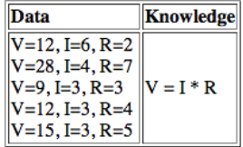
Definition and Importance of Knowledge
Knowledge
Note: knowledge != data.
Example: determining voltage from current and resistance
Knowledge is more compact and faster to manipulate.
Knowledge is more general (that is, may be applied to situations we have not been programmed for).
Important feature of intelligence: creating knowledge from data.

Slide 36
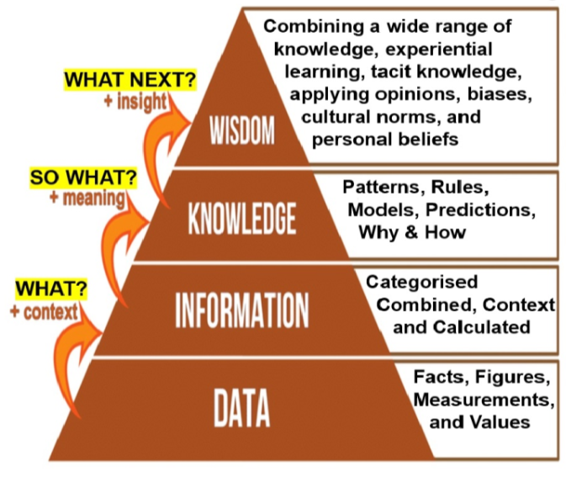
DIKW: Pyramid
The DIKW Pyramid explains how raw data becomes meaningful insight and ultimately intelligent decision-making.

Slide 37
DIKW: Pyramid
1. Data (Raw Facts)
Unprocessed, unstructured raw inputs collected from various sources such as sensors, user inputs, etc.
Does not have meaning on its own
Example: Temperature readings: 32, 35, 33
2. Information (Processed Data)
Data organized to provide meaning i.e. data that is cleaned, structured, and labeled
It helps in pattern recognition.
Example: Average temperature today is 33°C.

Slide 38
DIKW: Pyramid
3. Knowledge (Understanding Patterns)
Information combined with experience/rules that are used by machines to learn relationships from data and predict results.
Example: If temperature > 30°C, then it is hot.
4. Wisdom (Decision-Making)
Applying knowledge to make intelligent decisions such as decision making and providing recommendations.
Example: Smart thermostat lowers temperature automatically.

Slide 39
DKIW: Pyramid
Example 1: Smart Health Monitoring System
Data: Heart rate readings (e.g., 120 bpm)
Information: Heart rate is higher than normal
Knowledge: High heart rate may indicate stress or illness
Wisdom: Suggest to visit doctor or suggest rest
Example 2: Chatbot Based Recommendation System
Data: Words typed into a chatbot
Information: Text classified as “positive sentiment”
Knowledge: Positive sentiment means customer is satisfied
Wisdom: Recommender system suggests products to other customers as well

Slide 40
1.3 Cognition and Learning
Cognition
Cognition is the process by which humans acquire, process, store, and use information.
Key Cognitive Processes are:
Perception → interpreting information from senses (such as seeing, hearing)
Attention → focusing on specific information
Memory → storing and recalling information
Language → understanding and producing speech
Reasoning → thinking logically
Problem-Solving → finding solutions
Example: On seeing a red traffic light: Perception means seeing the light, memory & learning symbolize recognizing it means stop and reasoning & decision making includes deciding to stop.

Slide 41
Cognition in AI
In Artificial Intelligence, cognition refers to simulating human thinking processes that enables machines to understand language , learn from data and make decisions
Example in AI:
A chatbot understanding our question known as language cognition.
A recommendation system suggesting products known as decision-making cognition.
To enable cognition in AI, neuroscience, human cognition, and cognitive computing are tightly linked which forms a pipeline from understanding the brain to understanding thinking to finally building AI systems that mimic it.

Slide 42
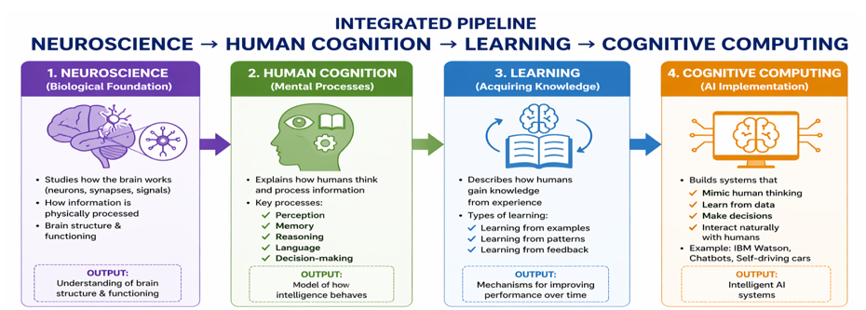
Cognition in AI

Slide 43
Cognition in AI
1. Neuroscience (Biological Foundation)
It is the study of how the human brain works i.e. understanding of neurons, synapses, signals.
Tries to find out “How does the brain physically process information?” .
Understands the structure of brain and its functioning.
2. Human Cognition (Mental Processes)
Explains how humans think and process information that includes perception , memory , reasoning and decision-making
It helps to create a model of how intelligent human behaves.

Slide 44
Cognition in AI
3. Learning (Acquiring Knowledge)
Describes how humans gain knowledge from experience .
Types are Learning from examples , Learning from patterns , Learning from feedback.
Helps to develop a mechanisms for improving performance over time.
4. Cognitive Computing (AI Implementation)
Helps to build systems that can mimic human thinking , learn from data and make decisions i.e. build an Intelligent AI systems.

Slide 45
Cognition in AI
Practical Example: Self-Driving Car
1. Neuroscience Inspiration
Human brain processes visual signals that inspires vision systems in AI.
2. Human Cognition
Driver sees road, recognizes objects, makes decisions.
3. Learning
AI system is trained on thousands of driving images & it learns patterns (lanes, pedestrians, signals).
4. Cognitive Computing
Car system understanding environment, predicting risks and deciding to brake, accelerate, or turn.

Slide 46
1.3 Cognition and Learning
What is Learning?
Learning is one of those everyday terms which is broadly and vaguely used in the English language
Learning is making useful changes in our minds.
Learning is constructing or modifying representations of what is being experienced.
Learning is the phenomenon of knowledge acquisition in the absence of explicit programming.
Herbert Simon, 1983- Learning denotes changes in the system that are adaptive in the sense that they enable the system to do the same task or tasks drawn from the same population more efficiently and more effectively next time.

Slide 47
1.3 Cognition and Learning
Learning involves 3 factors:
Changes
Learning involves changes in the individual who is learning, such as changes in their knowledge, beliefs, attitudes, or behaviors.
Generalization
Learning involves the ability to apply what has been learned in one situation to new and different situations.
Improvement
Learning involves continuous improvement over time.

Slide 48
1.4 Human Intelligence and Machine Intelligence
Artificial Intelligence (AI) | Human Intelligence (HI)
Intelligence demonstrated by machines through data processing and algorithmic learning. | The innate cognitive ability of humans to think, reason and adapt based on experience and emotions.
AI is simulative i. e. mimics human actions using computational logic. | HI is adaptive integrates emotion, experience and reasoning.
Operates through neural networks, algorithms and digital systems. | Operates through biological neurons and cognitive processes.
Learns through data, feedback loops and training datasets. | Learns through experiences, environment and social interaction.
Decision making by AI is objective and data-driven; lacks ethical or emotional context. | Decision making is subjective; influenced by logic, emotions and moral considerations.
Creativity is very limited to programmed boundaries & lacks imagination. | Capable of innovation, abstract thinking and creative expression.
Adapts only when re-trained with new data. | Adapts naturally to changing environments and situations.
Processes data at high speed with minimal error. | Slower in computation but excels in contextual reasoning.
Error rate is low as it depends on data quality and algorithm accuracy. | Error rate is higher as influenced by human bias, fatigue or emotional state.

Slide 49
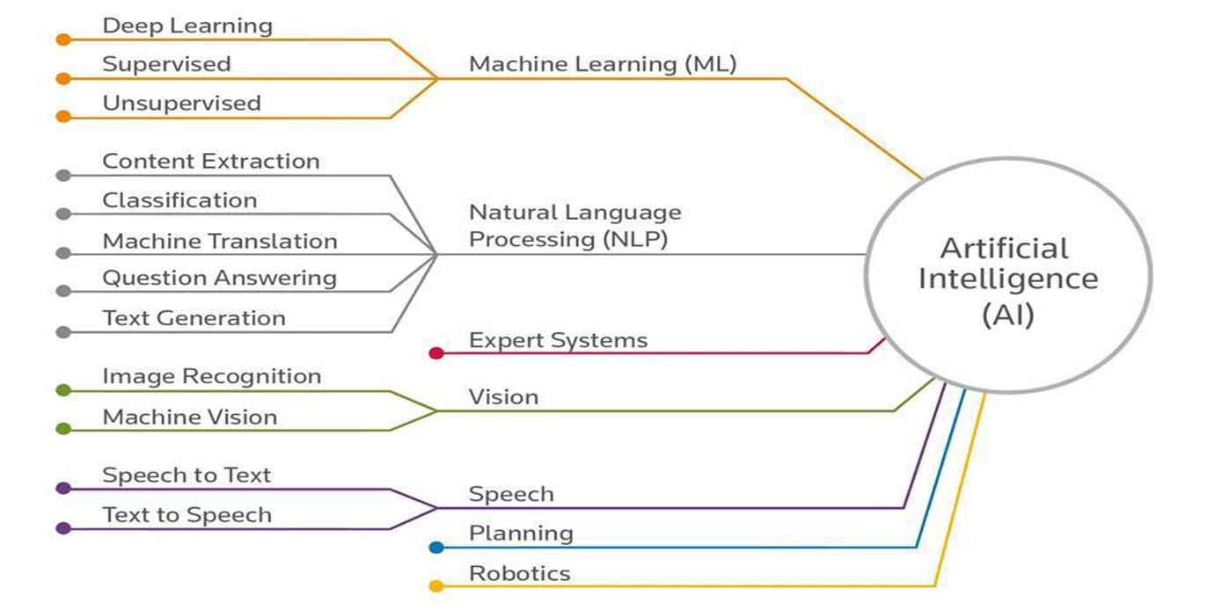
1.5 AI Tree: Branches and Interdisciplinary Nature
AI as a Tree

Slide 50
Interdisciplinary Nature/ Foundation of AI
Philosophy: Logic, methods of reasoning, mind as physical system, foundations of learning, language, rationality.
Mathematics: Formal representation and proof algorithms, computation, (un)decidability, (in)tractability, probability.
Economics: utility, decision theory, rational economic agents
Neuroscience: neurons as information processing units
Psychology: how do people behave, perceive, process Cognitive Science information, represent knowledge
Linguistics: knowledge representation, grammar

Slide 51
Application of AI
Artificial intelligence has been used in a wide range of fields including medical diagnosis, stock trading, robot control, law, remote sensing, scientific discovery and toys.
Many thousands of AI applications are deeply embedded in the infrastructure of every industry.
In the late 90s and early 21st century, AI technology became widely used as elements of larger systems, but the field is rarely credited for these successes.

Slide 52
Application of AI
1. Game Playing
Machines can play master level chess. There is some AI in them, but they play well against people mainly through brute force method, looking at hundreds of thousands of positions.
Few of the major achievements in game playing are:
In 2016, Google’s Deepmind AI named “ALphaGo Zero” defeated Lee Sedol by beating him in 4 games out of 5.
Lee Sedol was South Koera’s champion in Go.
Lee Sedol eventually retired from the game when in 2017 this AI next version was released.
In 2017, the next version of AI named “Alpha Go” beat World Champion Ke Jie in 3 matches out of 3.
In latest version, this AI beats the human opponents at the ratio of 100 out of 0.
Similarly, in 2017 AI Poker Bot beats World’s Best Player.

Slide 53
Application of AI
2. Speech Recognition
It is possible to instruct some computers using speech using Voice recognition system such as SIRI and CORTANA.
Some Applications are:
Voice Assistants (phones, smart homes)
Automated customer service (call centers)
Dictation & transcription systems
Accessibility tools (for visually impaired users)
Voice-controlled vehicles

Slide 54
Application of AI
3. Understanding Natural Language
To perform many natural language processing tasks such as machine translation, summarization, information extraction, need the AI in machine.
Some Applications are:
Conversational AI i.e. Chatbots & Virtual Assistants such as : Siri, Alexa, Google Assistant.
Machine Translation i.e. Converting text/speech from one language to another while preserving meaning. Examples: Google Translate
Email Filtering & Spam Detection. Example: Gmail automatically classifies emails into spam, promotions, or primary inbox
Grammar Checking & Writing Assistants. Examples: Grammarly
Autocomplete & Predictive Text used in Smartphones , Search engines, Messaging apps.

Slide 55
Application of AI
4. Computer Vision
Computer vision is concerned with the theory behind artificial system that extract information from images. The image data can take many forms such as videos sequences views from multiple cameras and data from a medical scanner.
Some Applications are:
Facial Recognition Systems used for phone unlocking, security & surveillance, auto tagging application in facebook.
Self-Driving Cars that uses cameras and AI to detect lanes, pedestrians, traffic signs. Example: Tesla Autopilot
Medical Image Analysis used in X-rays, MRI, CT scans to detect diseases like cancer, tumors, etc.
Image Search & Recognition used to identify objects, text, landmarks. Example: Google Lens
Industrial Quality Inspection used in manufacturing to detect defects in products and ensure quality control.

Slide 56
Application of AI
5. Expert System
Expert system needs the AI to perform its task.
Some Applications are:
One of the first expert system was MYCIN in 1974 which diagnosis bacterial infections of the blood and suggests treatments.
IBM’s “Watson” which is a question answer system used in healthcare and business analytics.
DENDRAL used in chemistry to identify molecular structures.
SOPHIE used to teach and troubleshoot electronic circuits.
PROSPECTOR used in geology to identify locations of mineral deposits.

Slide 57
Application of AI
6. Finance & Banking
AI is extensively used in finance and banking.
Some Applications are:
AI helps manage risk, detect fraud, and automate decisions.
Helps in Fraud detection by identifying suspicious transactions.
Assists with Algorithmic trading such as AI-driven stock market decisions.
Helps in assessing loan eligibility.

Slide 58
Application of AI
7. Hospitals and Medicine
Artificial neural networks are used as clinical decision support systems for medical diagnosis.
Some Applications are:
Heart sound analysis
Companion robots for the care of the elderly.
Helps in Drug discovery.
Chatbots for patient support.
Few achievements in this fields are:
Path AI and Philips helps in diagnosis of breast cancer with accuracy of 99%.
Google AI predicts inpatient death risks with 95% accuracy.

Slide 59
Application of AI
8. Identification Technologies
•Some Applications are:
Facial Recognition Systems such as Face ID & Clearview AI that are used for phone unlocking that identifies individuals based on facial features.
Fingerprint Recognition used in smartphones, biometric attendance systems that matches fingerprint patterns for identity verification.
Iris Recognition used in airports & National ID systems.
Voice Recognition such as Amazon Alexa & Google Assistant that can identify who is speaking used in secure authentication systems.
Signature Recognition used in banking document verification to analyze shape, stroke & speed of signature.

Slide 60
Application of AI
9. Manufacturing (Industry 4.0)
AI improves efficiency, quality, and automation of Industry.
Some Applications are:
Used in Predictive maintenance i.e. AI is used to detect machine failures before they occur.
Used in Quality control i.e. Computer vision for defect detection.
Smart robots in assembly lines.
10. Transportation & Logistics
Some Applications are:
AI enables smarter and safer mobility with development of autonomous vehicles such as self-driving cars.
Helps in faster delivery planning with Route optimization.
Helps in reducing congestion with traffic prediction.

Slide 61
Application of AI
11. Cybersecurity
AI enhances system security and threat detection.
Some Applications are:
Anomaly detection: Identifying cyber attacks
Malware detection
User behavior analytics
12. Bio-Technology
Some Applications are:
Drug Discovery & Development.
Genomics & DNA Analysis used for identifying disease-causing genes.
Agricultural Biotechnology used in disease detection in plants and smart farming.
Vaccine Development such as COVID-19 vaccine that could speeds up Antigen selection and Clinical trials.

Slide 62
1.6 Intelligent Agents and Types
Agent
An AI system is composed of an agent and its environment. The agents act in their environment. The environment may contain other agents.
An agent is anything that can be viewed as:
perceiving its environment through sensors and
acting upon that environment through actuators
Human agent:
eyes, ears, and other organs for sensors;
hands, legs, mouth, and other body parts for actuators
Robotic agent:
cameras and infrared range finders for sensors;
Various motors for actuators
Software agent:
Keyboard, microphone for sensors;
Screen, printer, speaker for actuators

Slide 63
Agents and environments
Performance Measure: determines how successful the agent is.
Behavior: activities the agent performs to achieve the goal
Percepts: formation of concepts based on the inputs.
Percept Sequence: set of all the perceptions till date
Agent Function: mapping of perception

Slide 64

Agents and environments
The agent function maps from percept histories to actions:
The agent program runs on the physical architecture to produce f,
agent = architecture + program
Architecture = the machinery that an agent executes on.
Agent Program = an implementation of an agent function

Slide 65
Vacuum Cleaner World
Percepts: location and state of the environment, e.g., [A,Dirty], [B,Clean]
Actions: Left, Right, Suck, NoOp

Slide 66
Rational agents
Rational Agent:
For each possible percept sequence, a rational agent should select an action that is expected to maximize its performance measure, based on the evidence provided by the percept sequence and whatever built-in knowledge the agent has.
Performance measure:
An objective criterion for success of an agent's behavior. E.g., performance measure of a vacuum-cleaner agent could be amount of dirt cleaned up, amount of time taken, amount of electricity consumed, amount of noise generated, etc.

Slide 67
Task Environment
Before we design an intelligent agent, we must specify its “task environment”.
Environment must be:
Fully observable
An agent’s sensors give it access to the complete state of the environment at each point in time
Deterministic
The next state of the environment is completely determined by the current state and the action executed by the agent.
Episodic
The agent’s experience is divided into atomic ”episodes” (each episode consists of the agent perceiving and then performing a single action
Static
The environment is unchanged while an agent is deliberating.

Slide 68
Task Environment
PEAS
PEAS define task environments about formulating the performance of intelligent agents. It stands for:
Performance measure
Environment
Actuators
Sensors

Slide 69
Task Environment
Q. Point out the task of designing an automated taxi driver according to PEAS description.
Agent= taxi-driver
Performance measure: Safe, fast, legal, comfortable trip, maximize profits
Environment: Roads, other traffic, pedestrians, customers
Actuators: Steering wheel, accelerator, brake, signal, horn
Sensors: Cameras, sonar, speedometer, GPS, engine sensors

Slide 70
Task Environment
Q. Point out the task of designing a Medical diagnosis system according to PEAS description.
Agent= Medical diagnosis system
Performance measure: reliable, minimize costs, legal, highly responsive
Environment: Patient, hospital, staff, bed, pharmacy
Actuators: Screen display, printer, speaker (questions, tests, diagnoses, treatments, referrals)
Sensors: Keyboard, mouse, microphone (entry of symptoms, findings, patient's answers)

Slide 71
Task Environment
Q. Point out the task of designing a Part picking Robot according to PEAS description.
A. Agent = Part-picking robot
Performance measure: Percentage of parts in correct bins, fast, safe
Environment: Conveyor belt with parts, bins
Actuators: Jointed arm and hand
Sensors: Camera, joint angle sensor

Slide 72
Types of Agents
Simple Reflex Agent
Model Based Agent
Goal Based Agent
Utility Based Agent
Learning (Intelligent) Agent

Slide 73
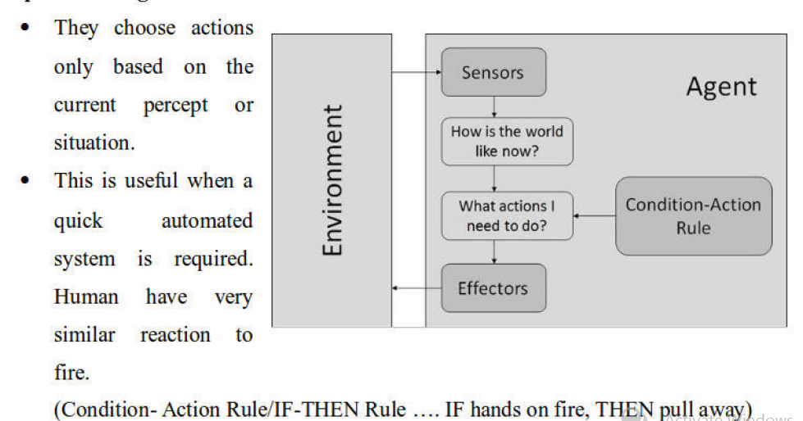
Types of Agent
1. Simple Reflex Agent

Slide 74
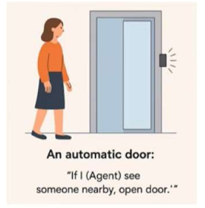
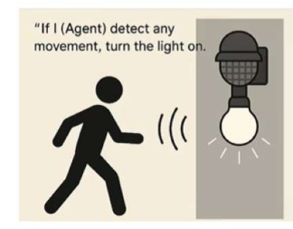
Simple Reflex Agent
Key Characteristics
1. No memory of past events
It does not store past states or learn over time. It only reacts to what it sees now.
2. Uses condition–action rules
Example: If obstacle ahead → turn left
If temperature > 30°C → turn on fan
3. Fast and simple
Because it doesn’t think or plan, it responds quickly.
4. Limited intelligence
Fails when: The environment is partially observable and the correct action requires history or reasoning.
Example:
1. Thermostat
If temperature < 20°C → turn on heater
If temperature > 20°C → turn off heater
2. Traffic Light Control (basic)
If timer expires → switch light
3. Smoke Detectors
If smoke detected → raise alarm.

Slide 75
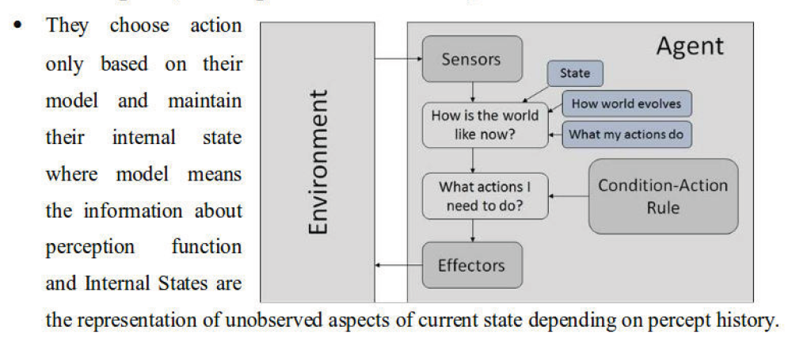
Types of Agent
2. Model Based Agent

Slide 76
Model Based Agent
A model-based agent maintains an internal representation (a model) of the part of the world it cannot directly observe. It updates this model using:
Percept history (everything it has sensed so far)
Knowledge of how the world works (transition model)
Then it uses this updated model to choose actions.
It is like simple reflex agent with memory and this memory is called the “model of the world.”
Key Components:
1. World Model
A stored internal description of the environment: What the agent believes is true, What objects exist, Where things are, What it last saw.
2. Transition Model
Knowledge about how actions change the world: “If I clean a dirty tile, the tile becomes clean.”
3. State Update
After each action or percept, the agent updates its internal state.
4. Decision Making
The agent selects the next action based on: Internal state, Goals, Rules

Slide 77
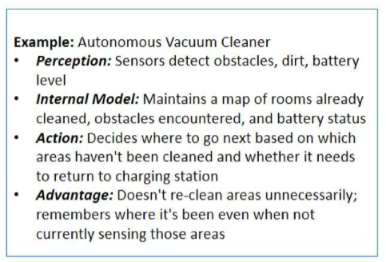
Model Based Agent
Example: Vacuum-Cleaner Agent
If the sensor shows only the current tile, but cannot see others, the agent uses a model to remember which tiles were dirty earlier.

Slide 78
Model Based Agent
Real-World Examples:
Self-driving cars tracking surrounding vehicles
Robots navigating rooms without full visibility
Smart thermostats learning usage patterns
Chess program remembering board position
A navigation system choosing routes based on traffic to reach a destination.

Slide 79
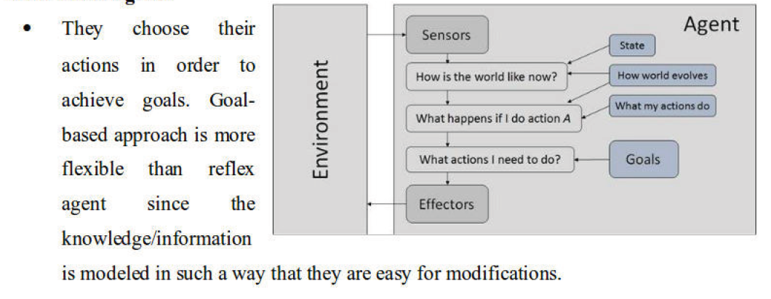
Types of Agent
3. Goal Based Agent

Slide 80
Goal Based Agent
A goal-based agent is an intelligent agent that selects actions to achieve a desired goal state.
It evaluates possible sequences of actions (plans) and chooses the one that leads to the goal.
Key Characteristics
Has explicit goals
A goal defines: Desired states, Conditions to satisfy, Example: “Reach the destination safely.”
2. Uses search and planning
Because actions affect the world, the agent must choose a path. Examples of planning: BFS, DFS, A*, heuristic search
3. Considers future consequences
Unlike reflex agents, it doesn’t just react. It may choose actions that do not provide immediate reward but help reach the goal. Example: A self-driving car may slow down now to take a correct turn later.
4. Requires a model of how actions change the world
The agent needs: A representation of the world and A transition model: If I do action A in state S → next state S’

Slide 81
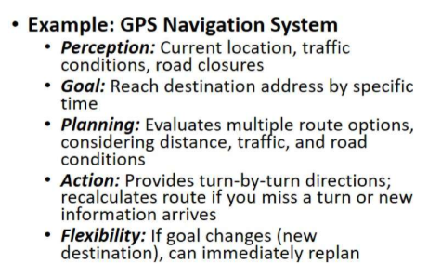
Goal Based Agent
Real World Examples:
Delivery robots planning paths through buildings.
AI game players determining moves to win.
Project management software scheduling task to meet deadlines.

Slide 82
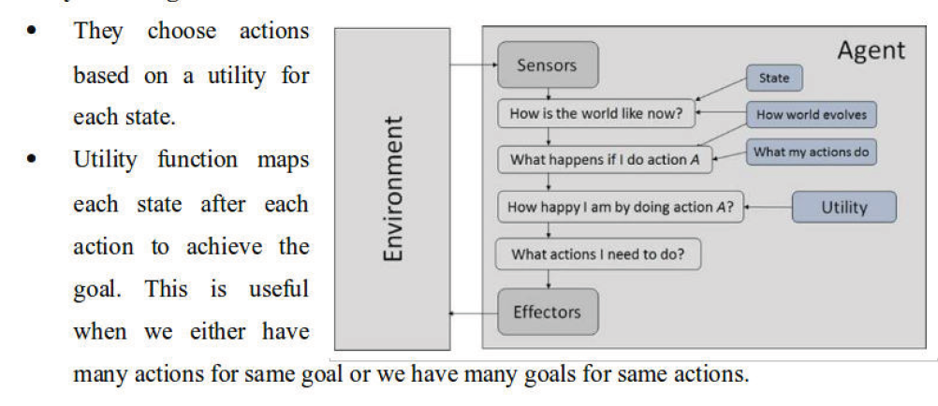
Types of Agent
4. Utility Based Agent

Slide 83
Utility Based Agent
A utility-based agent is an AI agent that selects actions based on a utility function, which maps each possible state to a numerical value indicating how desirable that state is.
Goal-based agent → “Is this state good or bad?”
Utility-based agent → “How good exactly is this state compared to others?”
Key Characteristics
1. Uses a utility function
A utility function assigns a value like: 0 → worst outcome, 1 → best outcome or any numerical range. Example: For a self-driving car: Utility = safety score + comfort score + speed benefit.
2. Chooses the action with highest expected utility
If outcomes are uncertain, it computes: Expected Utility = Σ (Probability × Utility).
This lets it handle: Risk, Uncertainty, Trade-offs
3. Handles conflicting goals
A utility-based agent can balance: Safety vs. speed, Cost vs. quality, Comfort vs. time.

Slide 84
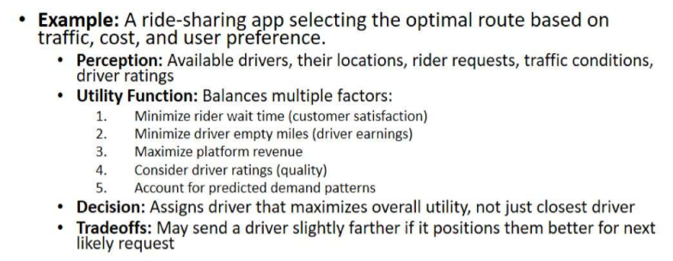
Utility Based Agent

Slide 85
Utility Based Agent
Examples of Utility-Based Agents:
1. Self-driving Cars
Evaluates:
safety (high utility)
speed (medium utility)
fuel use (low utility)
2. Recommendation Systems
Utility = how much user might like the item.
3. Investment AI
Utility = profit × risk management.
4. Game AI (Chess, GO)
Utility = board position score.

Slide 86
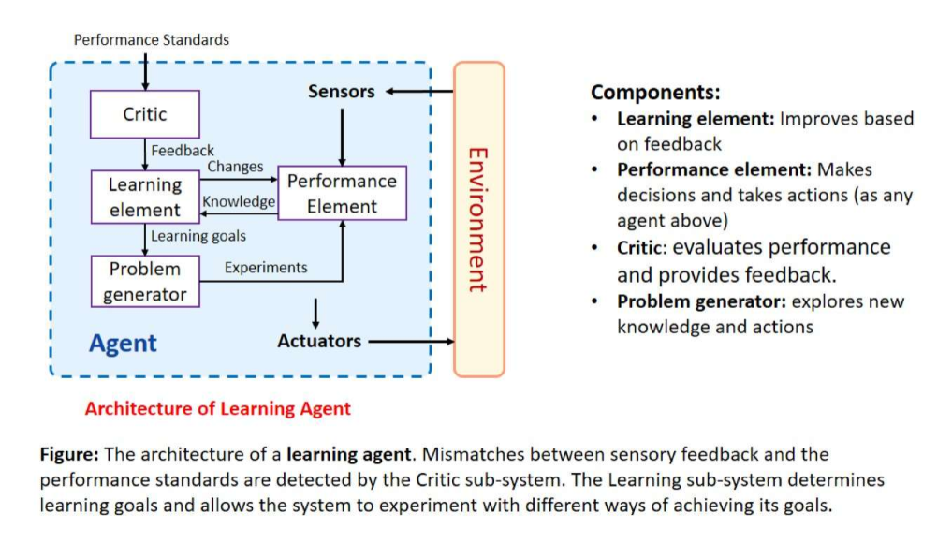
Types of Agents
5. Learning (Intelligent) Agent
Improves performance over time through experience, adapting to new situations and discovering better strategies autonomously.

Slide 87
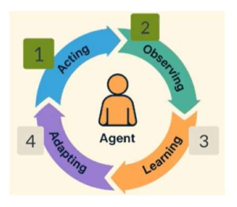
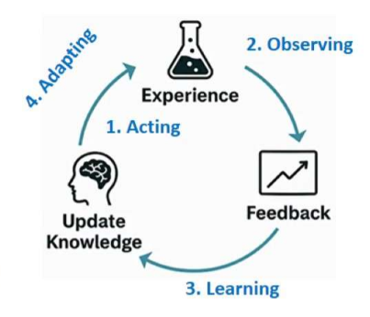
Learning (Intelligent) Agent
Key Characteristics:
Adapts to changing environments.
Discovers new strategies not explicitly programmed.
Continuously improves with experience.

Slide 88
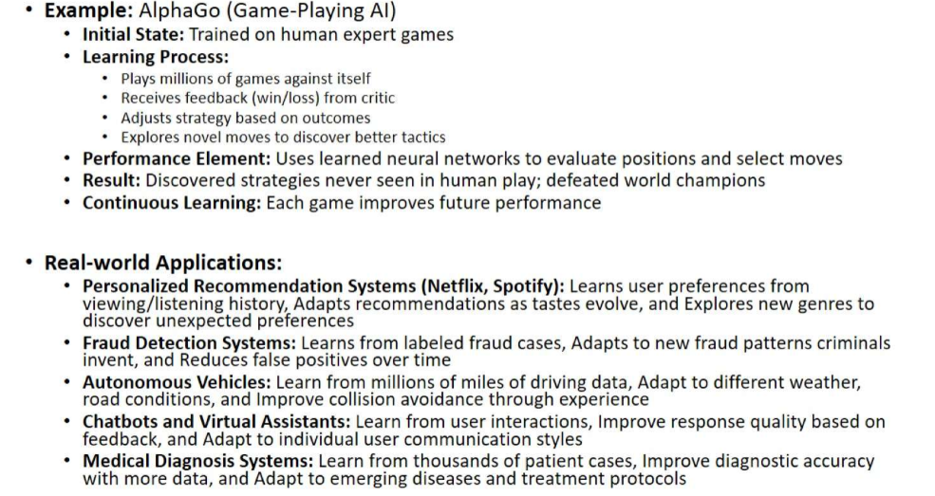
Learning (Intelligent) Agent

Slide 89
1.7 Agentic AI
Agentic AI refers to AI systems that can act autonomously to achieve goals where they don’t just respond to inputs, they plan, decide, and take actions over time.
A traditional AI answers a question and stops whereas an agentic AI when given a goal, figures out on its own the sequence of steps, tool to be used, and decisions needed to achieve it. It keeps acting until the job is done.
In Agentic AI, an AI agent behaves like a goal-driven entity that can understand a task, break it into steps, make decisions, execute actions and learn from results.
We can think of the difference between asking a person "what's the weather?" vs. asking them to "plan and book your entire trip to Pokhara." The second requires initiative, judgment, and a series of actions over time. That's agentic.

Slide 90
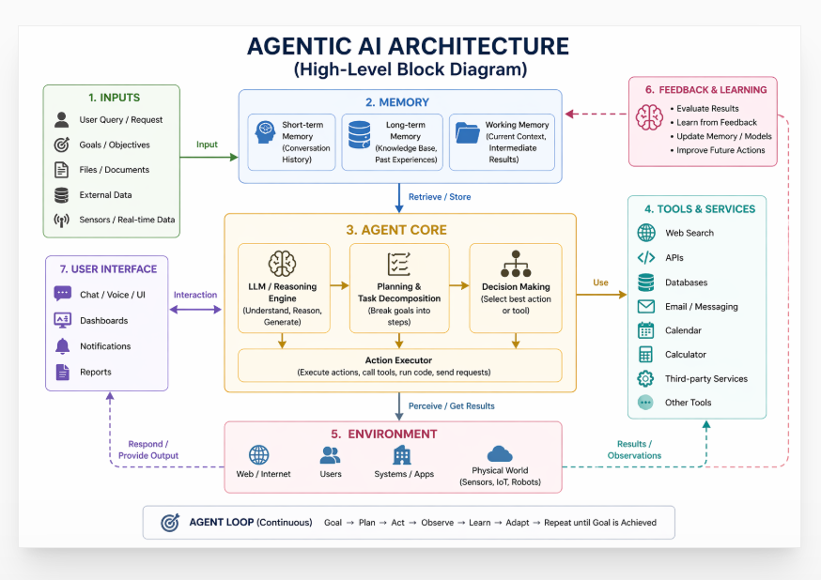
Agentic AI Architecture (The Core Loop)

Slide 91
Agentic AI Architecture (The Core Loop)
Every agentic AI runs through this cycle continuously:
Perceive
The agent reads its environment i.e. the original goal, prior conversation, available tools, and any memory from earlier steps.
2. Reason & Plan
It breaks the goal into sub-tasks, decides what order to tackle them, and selects which tools to use. Use of LLMs and Reasoning is done to plan the execution of the tasks.
3. Act
It executes the plan by calling a search API, running code, writing a file, clicking a browser, or calling another AI agent.
4. Observe
It reads the result of its action, updates its understanding, and loops back to perceive to adjust the plan if something goes wrong.

Slide 92
Agentic AI
Characteristics of Agentic AI:
Very goal-oriented as it works toward achieving a defined objective.
Can operate without constant human input.
Breaks complex problems into smaller steps and chooses the best path to achieve goal.
Remembers past interactions and improves performance over time.
Can use external tools such as APIs ,Databases and Web search.

Slide 93
Agentic AI
Real World Examples:
1. Autonomous Vehicles
Used to perceive environment using cameras and sensors, plan routes , make driving decisions and continuously adapt . Examples: Tesla Autopilot, Waymo
2. AI Personal Assistants
Used to handle multi-step tasks like scheduling meetings, sending emails , interacting with multiple services , learning user preferences . Examples: Google Assistant, Amazon Alexa
3. AI Coding Agents
Used to write code, debug errors , suggest improvements , execute multi-step programming tasks . Examples: GitHub Copilot, auto-GPT
4. Customer Support AI Agents
Used by companies for handling customer queries , resolving issues & escalating when needed. Example: Zendesk AI
5. Financial Trading Bots
Used in stock markets to analyze market trends, risk factors and automatically buy/sell stocks . Example: Goldman Sachs AI trading systems

Slide 94
Agentic AI
Challenges/ Risks
Incorrect Decision-Making/ Compounding Errors
Hallucinations
Trust & Verification
Ethical Concerns/ Accountability
Over-Autonomy Risks
Security

Slide 95
References
Stuart Russel and Peter Norvig, Artificial Intelligence A Modern Approach, Pearson
E. Rich and Knight, Artificial Intelligence, McGraw Hill, 1991.

